Slide 1


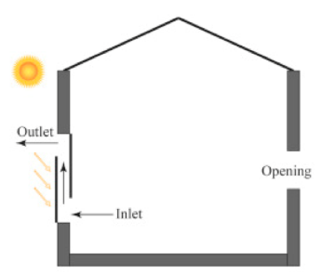
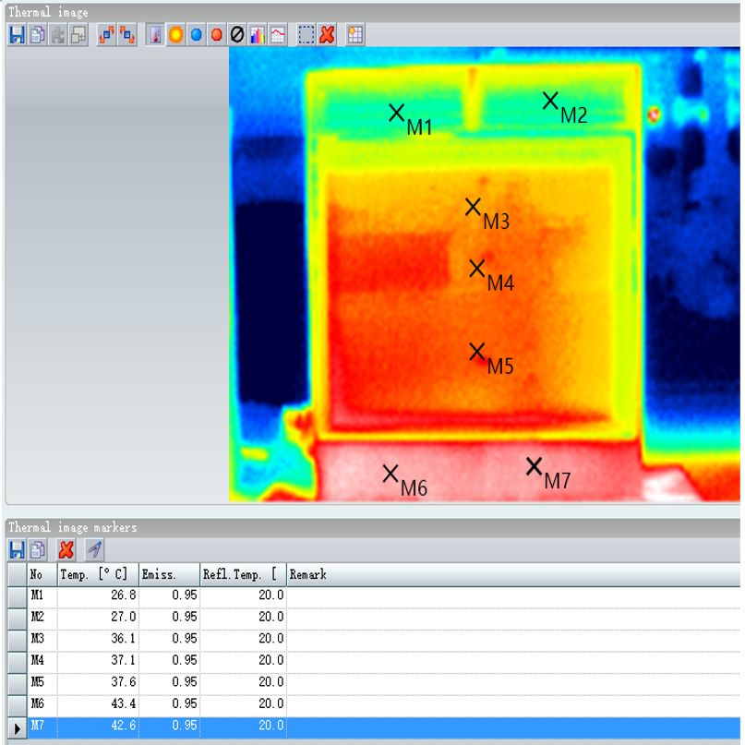
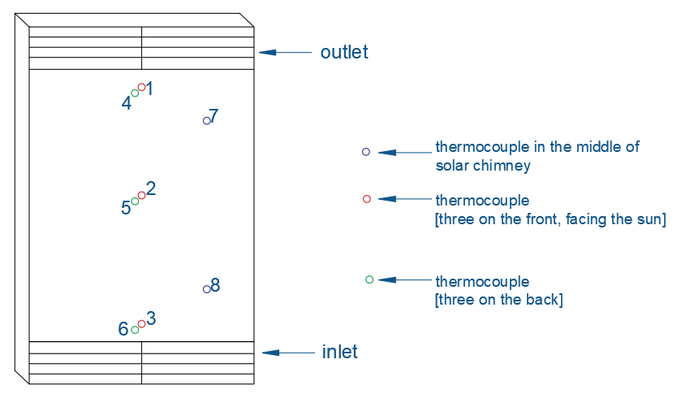
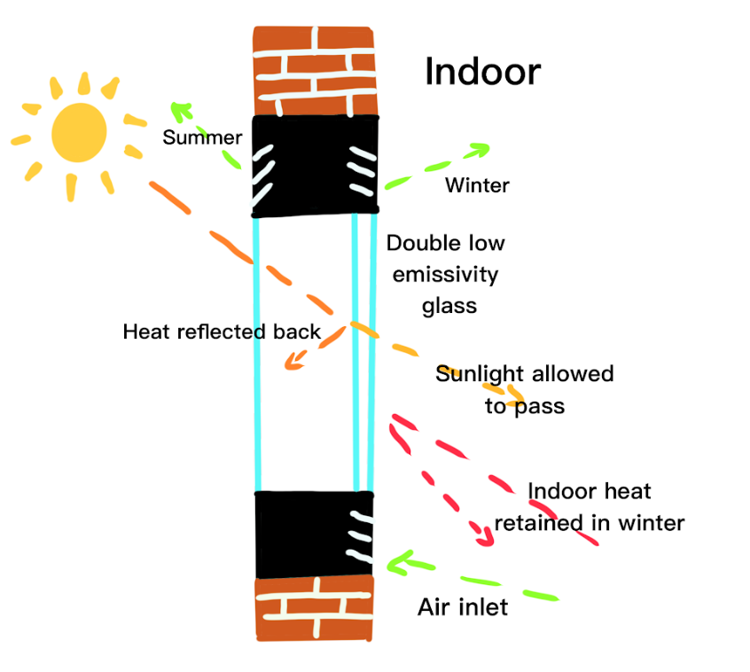
Determining the viability of solar chimney homes under Victoria’s climate Experimental tests
Supervisor: Dr. Long Shi
Student Name: Haoze Xia; Junxu Jin; Jarrod Lawson
Student Number: s3595897; s3599541; s3582207
Introduction
The design of any solar chimney is limited by sunlight and ambient temperature. In winter conditions where the average temperature will be cold and the available solar radiation is also low, it is expected that the solar chimney will not perform at all. This is a considerable disadvantage of the solar chimney.
Channel | 1 | 2 | 3 | 4 | 5 | 6 | 7 | 8 | Average Ambient Temperature | Average Solar Radiation W/m^2
 | 34.97 | 36.33 | 35.97 | 26.99 | 33.61 | 33.4 | 23.82 | 24.73 | 21 | 883
For Victoria, the use of solar chimneys is very minimal due to the limited research knowledge of its performance in the region’s climate. While it is recognized as a great benefit to a home in hot arid climates where the sun shines bright – Victoria’s climate is vastly different with cold winters and overcast days. The solar chimney was medium sized, with front sun facing single glazed pane of glass and low emissive double-glazed sheet of glass at the rear. The test focused on the increase of air temperature when configured to draw in cool air from the bottom and exhaust it at the top.
Table 1. Temperature and Solar Radiation
 | Air inlet Speed m/s | Temperature
Mean | 0.51 | 28.4
Max | 2.68 | 32.65
Min | 0.02 | 25.25
Table 2. Air Speed
Figure 1. Solar Chinmey-Trombe Wall
Background
Results
With the environment becoming ever important and fossil fuels slowly diminishing, solar thermal technologies have been investigated as a sustainable alternative [1, 2]. The use of a solar chimney benefits a home’s ventilation reducing the need and demand of traditional heating and cooling [3, 4] This works on the principle of solar radiation penetrating a glass wall and heating the air inside. The heat increase causes the air to rise drawing fresh air from an opening below [5]. This ventilation can be used in different ways, primarily it is to heat and cool the room the chimney is attached to [6, 7]. To cool a room, the chimney draws air from inside the room, then expels it outside at the top of the chimney. With a door or window open on the other side, fresh air can enter the room cooling the mean temperature of the room [8, 9]. Coupled with insulation in the building to reduce natural heat gains [10], this overall is proven to be an effective method to cool and ventilate a building without any electrical input [11]. Furthermore, solar chimneys can also function as a heater in two ways, drawing air from outside, heating and ventilating inside the connected room providing fresh warm air. Or alternatively, acting like a convection heater, sucking the air inside and heating it in a circular effect [12, 13].
Solar chimneys perform on the sole requirement that there is enough solar radiation and its effectiveness relies on this property [14]. It has been proven that even during night hours, hot arid climates work just as well [15]. In locations where it is humid such as Singapore, there is still a need for air-conditioned intervention. Although a solar chimney can reduce its use saving operational costs [16]. All this research conducted in warm climates illustrates the need for experimental testing in cooler climates. While low solar radiation tests have been performed, there is a lack of consideration to the other effects that come with a cooler climate.
To record the experimental data, let the solar chimney single-glazing facing to the sun, using the measurement instruments to record the air outlet speed every 5 second and solar chimney different location’s temperatures for an hour.
Figure 6. Infrared Image of Solar Chimney
Theory Explanation
Low Emissivity Glass
Figure 2. Thermocouple locations
Figure 3. Radiation
Figure 7. Double Low Emissivity glass
Conclusions
This testing proved solar chimneys viability in Victoria. On sunny clear days the solar chimney performed as expected increasing the air temperature by an average of 3 degrees. In relation to the design there was stability in testing due to the materials in the design. The bottom black plate at the front of the chimney was hot as shown in infrared images. This stabilized the temperature significantly assisting with heating ambient air when the solar radiation levels dropped away momentarily. While this design element is outside of scope – it is an important talking point that should be considered and further explored in future. Contrary to this success, when no sunlight was observed, the chimney cannot generate heat. Further to this we observed on cold winter days the solar chimney under performed.
Figure 4. Thermocouple Temperatures
Figure 5. Intake Wind Speed
References
[1] M. Thirugnanasambandam, S. Iniyan, and R. Goic, "A review of solar thermal technologies," Renewable & Sustainable Energy Reviews, vol. 14, no. 1, pp. 312-322, Jan 2010, doi: 10.1016/j.rser.2009.07.014.
[2] L. Shi and M. Y. L. Chew, "A review on sustainable design of renewable energy systems," Renewable & Sustainable Energy Reviews, vol. 16, no. 1, pp. 192-207, Jan 2012, doi: 10.1016/j.rser.2011.07.147.
[3] R. Khanal and C. W. Lei, "Solar chimney-A passive strategy for natural ventilation," Energy and Buildings, vol. 43, no. 8, pp. 1811-1819, Aug 2011, doi: 10.1016/j.enbuild.2011.03.035.
[4] N. K. Bansal, R. Mathur, and M. S. Bhandari, "SOLAR CHIMNEY FOR ENHANCED STACK VENTILATION," Building and Environment, vol. 28, no. 3, pp. 373-377, Jul 1993, doi: 10.1016/0360-1323(93)90042-2.
[5] C. Afonso and A. Oliveira, "Solar chimneys: simulation and experiment," Energy and Buildings, vol. 32, no. 1, pp. 71-79, Jun 2000.
[6] H. Y. Chan, S. B. Riffat, and J. Zhu, "Review of passive solar heating and cooling technologies," Renewable & Sustainable Energy Reviews, vol. 14, no. 2, pp. 781-789, Feb 2010, doi: 10.1016/j.rser.2009.10.030.
[7] G. H. Gan, "A parametric study of Trombe walls for passive cooling of buildings," Energy and Buildings, vol. 27, no. 1, pp. 37-43, Feb 1998, doi: 10.1016/s0378-7788(97)00024-8.
[8] D. J. Harris and N. Helwig, "Solar chimney and building ventilation," Applied Energy, vol. 84, no. 2, pp. 135-146, Feb 2007, doi: 10.1016/j.apenergy.2006.07.001.
[9] J. Arce, M. J. Jimenez, J. D. Guzman, M. R. Heras, G. Alvarez, and J. Xaman, "Experimental study for natural ventilation on a solar chimney," Renewable Energy, vol. 34, no. 12, pp. 2928-2934, Dec 2009, doi: 10.1016/j.renene.2009.04.026.
[10] M. Santamouris, K. Pavlou, A. Synnefa, K. Niachou, and D. Kolokotsa, "Recent progress on passive cooling techniques - Advanced technological developments to improve survivability levels in low-income households," Energy and Buildings, vol. 39, no. 7, pp. 859-866, Jul 2007, doi: 10.1016
[11] D. Park and F. Battaglia, "Application of a Wall-Solar Chimney for Passive Ventilation of Dwellings," Journal of Solar Energy Engineering-Transactions of the Asme, vol. 137, no. 6, Dec 2015, Art no. 061006, doi: 10.1115/1.4031537.
[12] X. Q. Zhai, Y. J. Dai, and R. Z. Wang, "Comparison of heating and natural ventilation in a solar house induced by two roof solar collectors," Applied Thermal Engineering, vol. 25, no. 5-6, pp. 741-757, Apr 2005, doi: 10.1016/j.applthermaleng.2004.08.001.
[13] G. Ziskind, V. Dubovsky, and R. Letan, "Ventilation by natural convection of a one-story building," Energy and Buildings, vol. 34, no. 1, pp. 91-102, Jan 2002, doi: 10.1016/s0378- 7788(01)00080-9.
[14] J. Mathur, N. K. Bansal, S. Mathur, M. Jain, and Anupma, "Experimental investigations on solar chimney for room ventilation," Solar Energy, vol. 80, no. 8, pp. 927-935, 2006, doi: 10.1016/j.solener.2005.08.008.
[15] M. M. AboulNaga and S. N. Abdrabboh, "Improving night ventilation into low-rise buildings in hot-arid climates exploring a combined wall-roof solar chimney," Renewable Energy, vol. 19, no. 1-2, pp. 47-54, Jan-Feb 2000, doi: 10.1016/s0960-1481(99)00014-2.
[16] A. Y. K. Tan and N. H. Wong, "Influences of ambient air speed and internal heat load on the performance of solar chimney in the tropics," Solar Energy, vol. 102, pp. 116-125, Apr 2014, doi: 10.1016/j.solener.2014.01.023.

